Slide 1
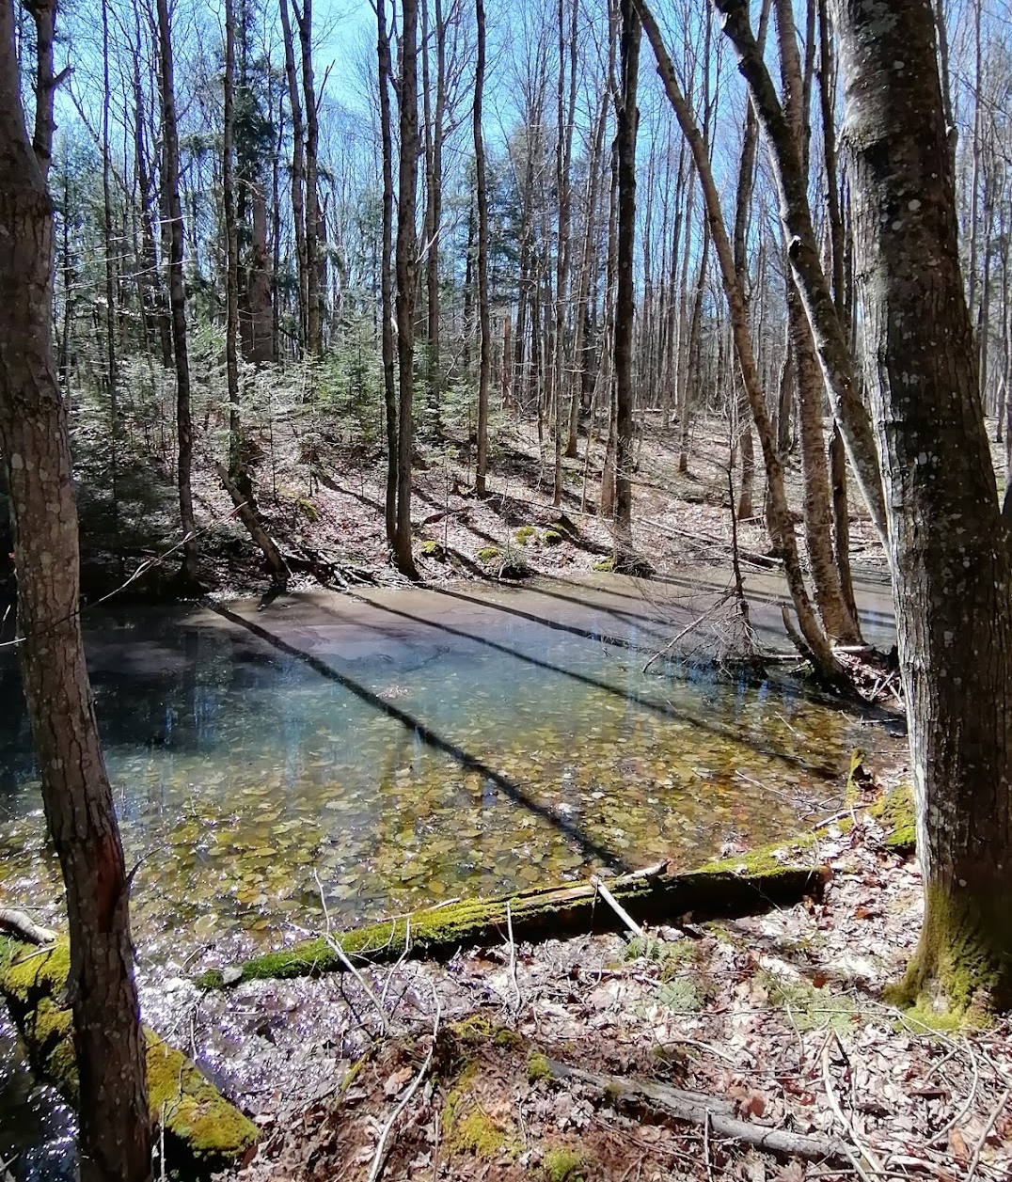
Mapping and Conservation of Vernal Pools Across National Parks in the Great Lakes Region
Sam Kurkowski
MS Applied Ecology
College of Forest Resources and Environmental Science
Michigan Technological University
Notes:
All photos and maps not cited were made by me!!

Slide 2
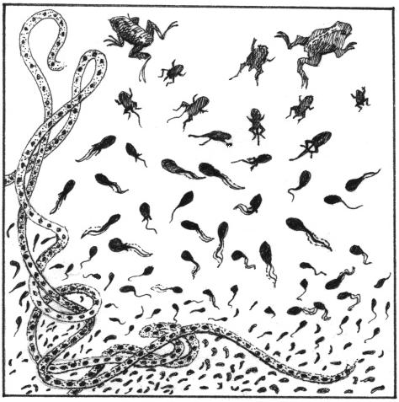
OUTLINE
Vernal pool background
Mapping vernal pools
Research questions/methods
2022 Field Work
Preliminary results
Source: https://www.adirondackalmanack.com/wp-content/uploads/2015/ 05/Vernal_pools.jpg

Slide 3
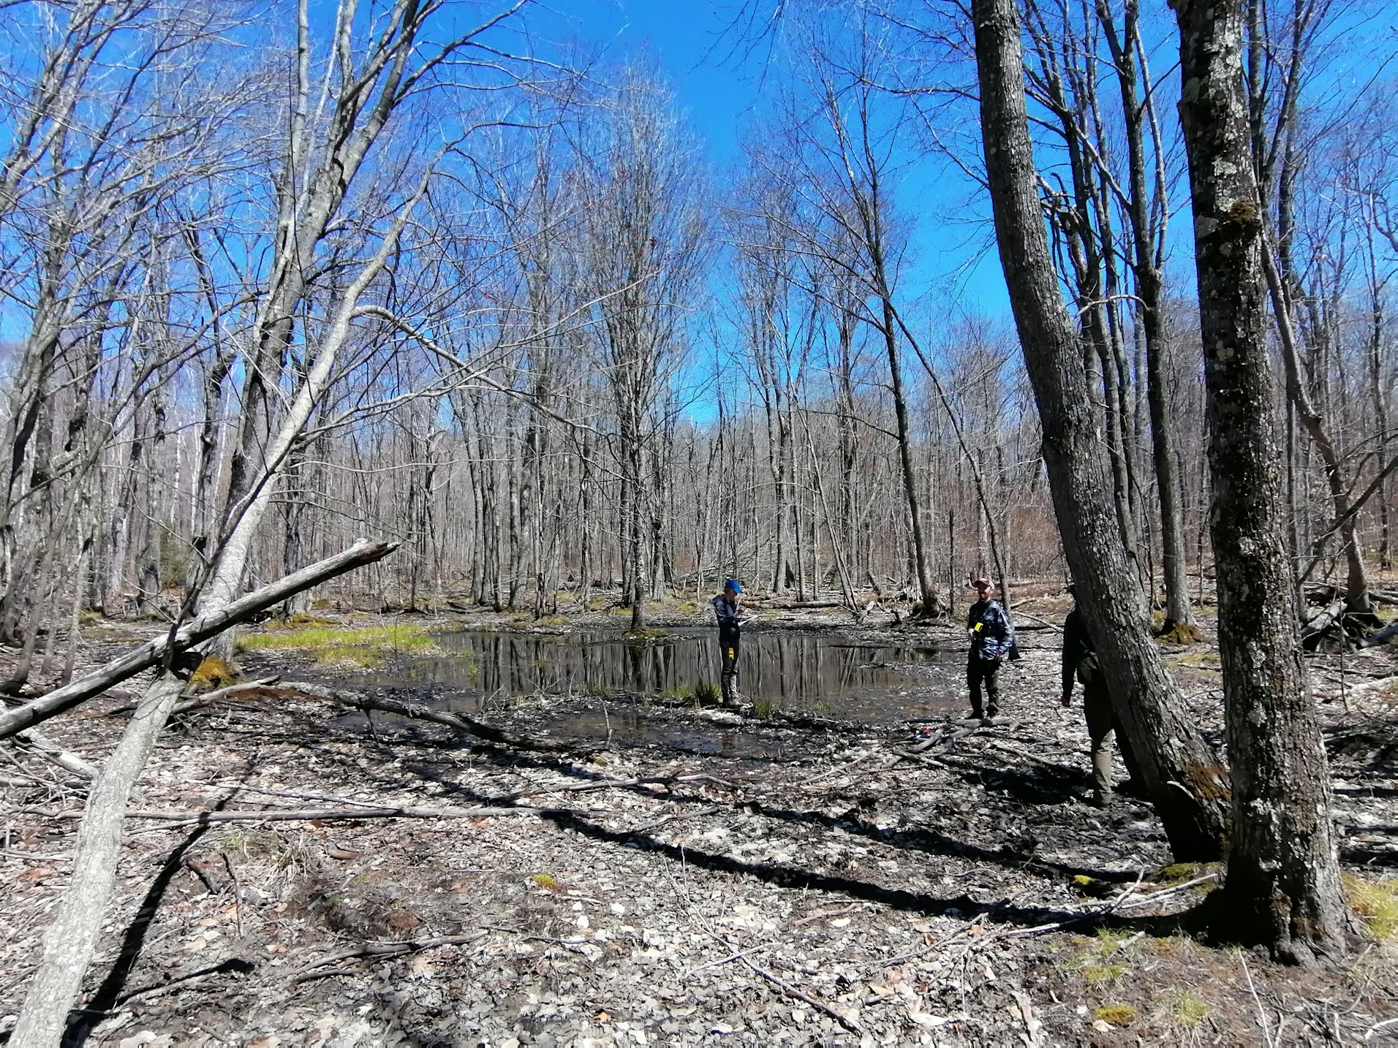
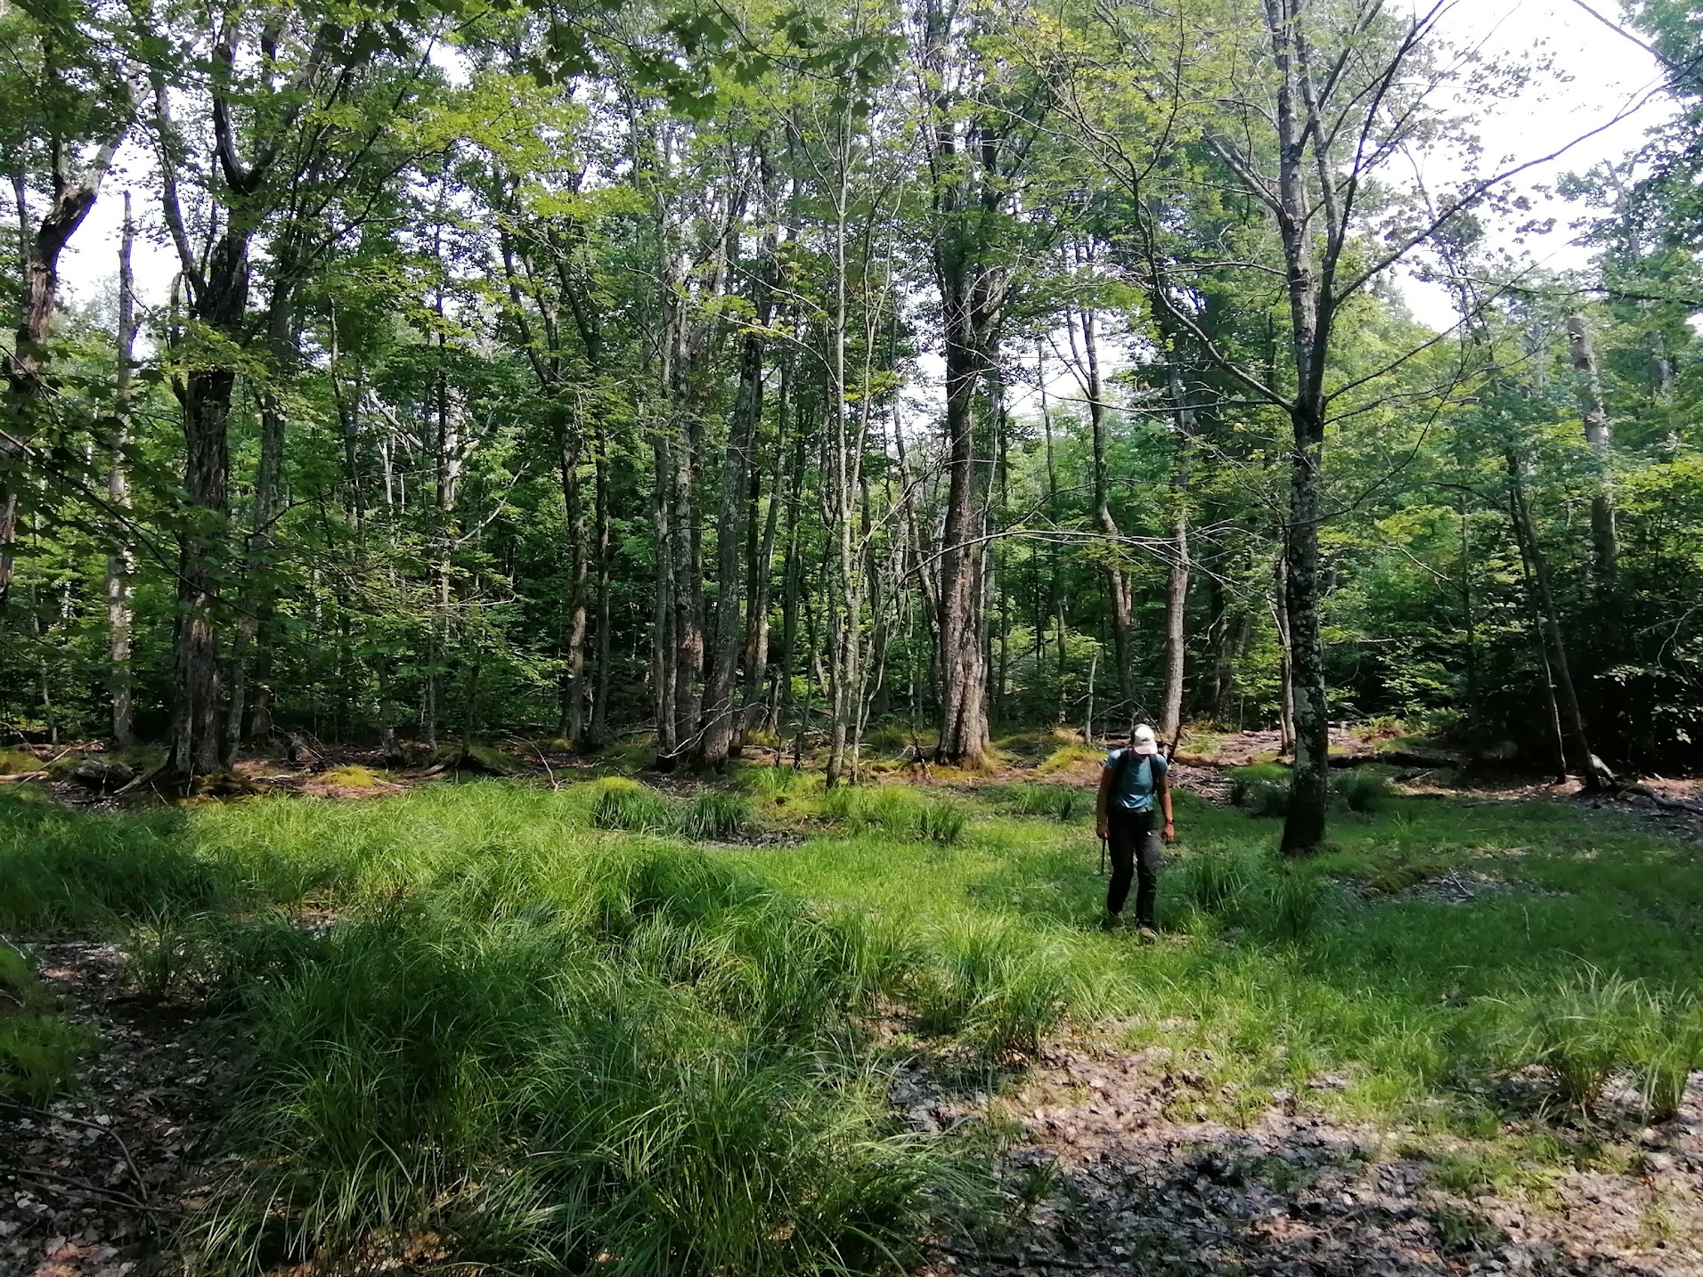
What are vernal pools?
Small, isolated depressions that hold water temporarily during the spring and often dry out by summertime
Notes:
Small means less than 0.2 hectare

Slide 4
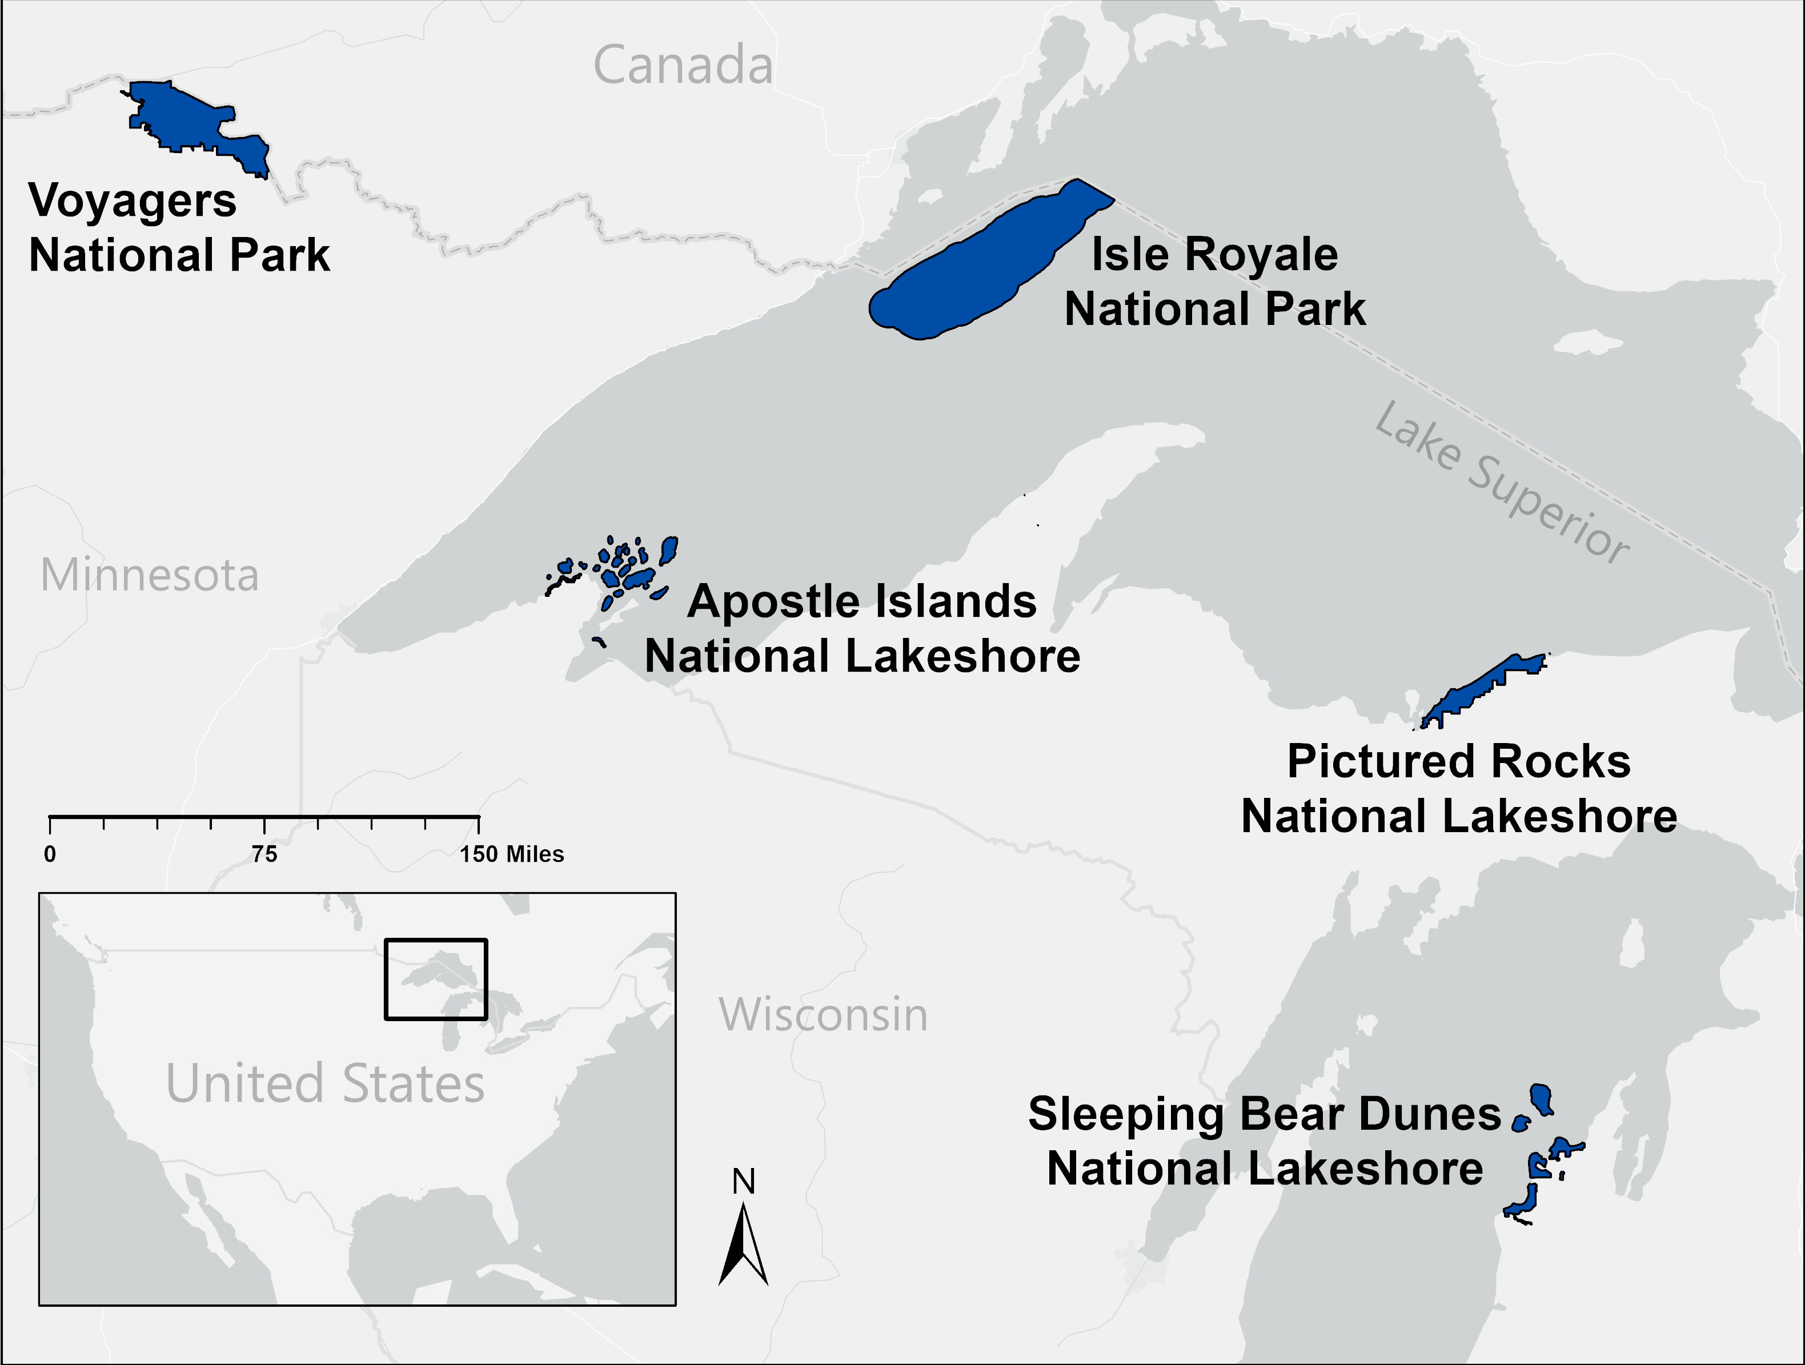
Mapping Vernal Pools
Voyagers
Apostle Islands
Pictured Rocks
Sleeping Bear
Isle Royale

Slide 5
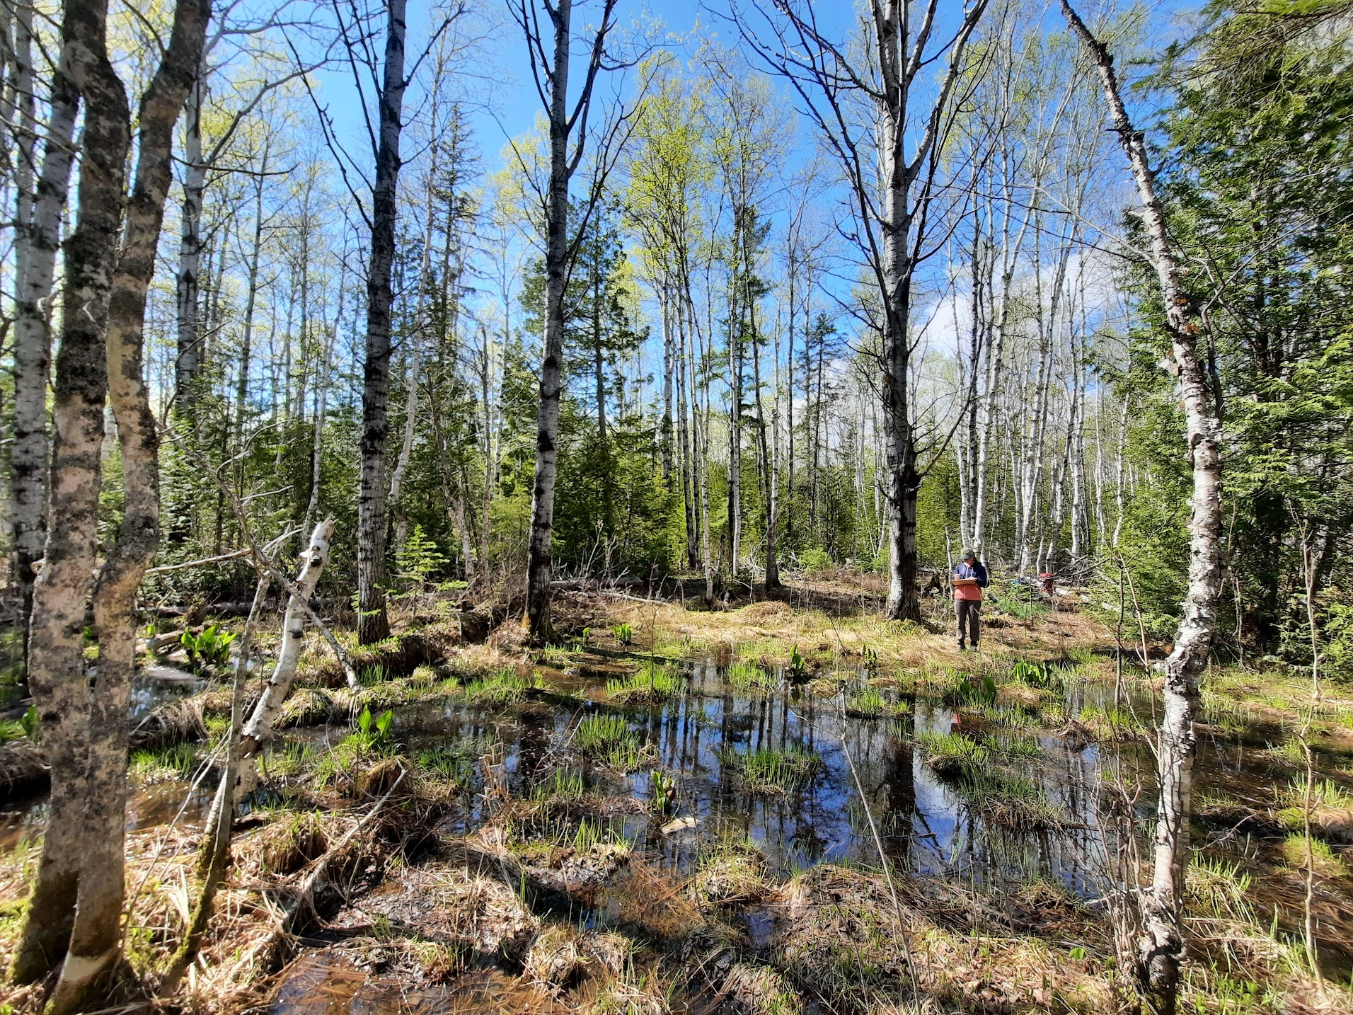
Research questions
Where on the landscape are vernal pools found in terms of geomorphology and forest structure?
How do pool characteristics change across the region?
What pool characteristics provide high quality habitat for amphibians?
- Create a classification system
Notes:
What kinds of forests, soils, and geomorphology do they occur on?
Inform mapping methods
Larger dataset across more than one area is helpful
Also be able to look at if landscape patterning plays a role in amphibian vernal pool use
Could look at pool connectivity and historic land use

Slide 6
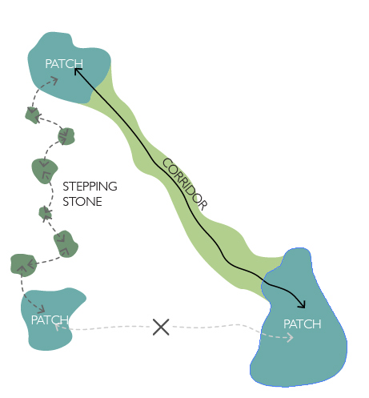
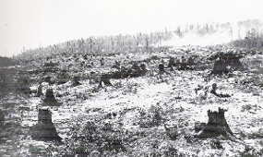
What’s next?
More avenues to explore
Historic land use
Landscape connectivity of pools
Source: https://www.nps.gov/slbe/learn/historyculture/ghosttowns.htm
Source: https://content.yardmap.org/wp-content/uploads/2015/08/Connectivity.jpg

Slide 7
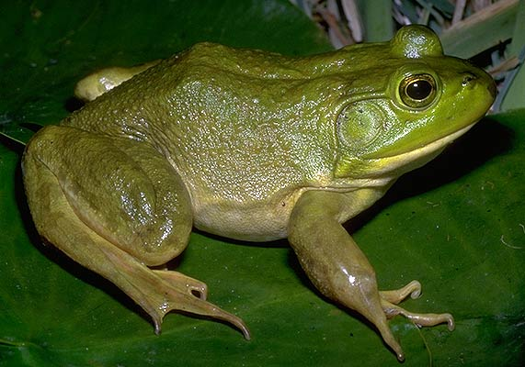
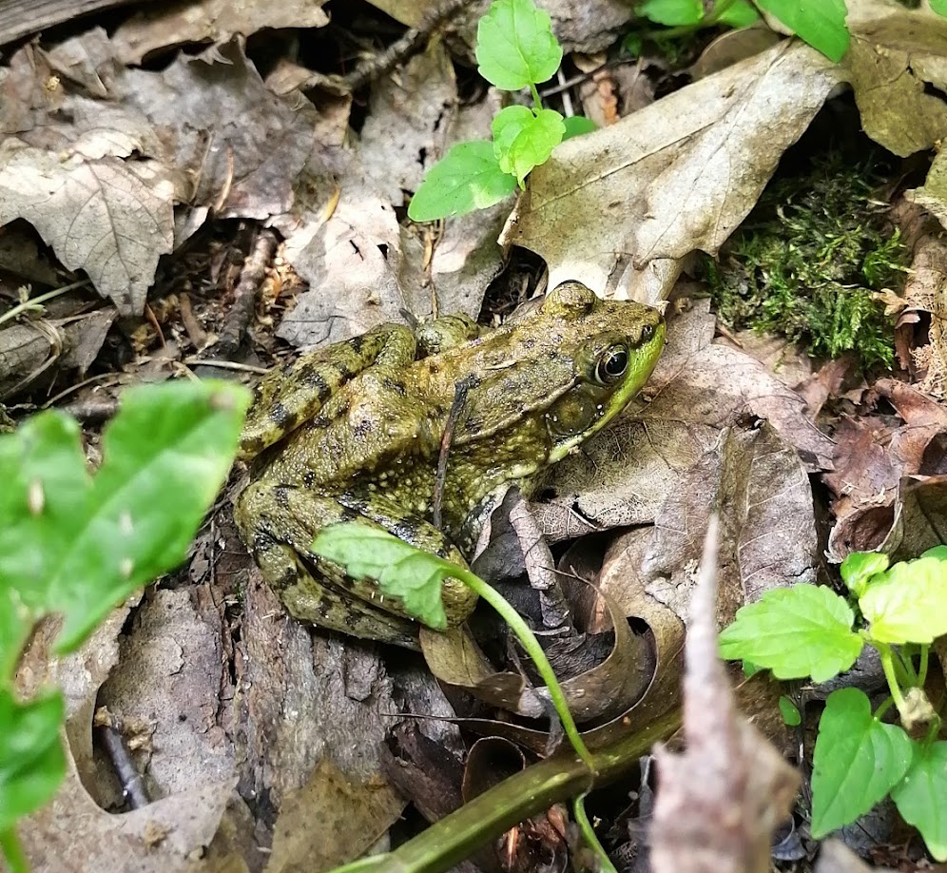
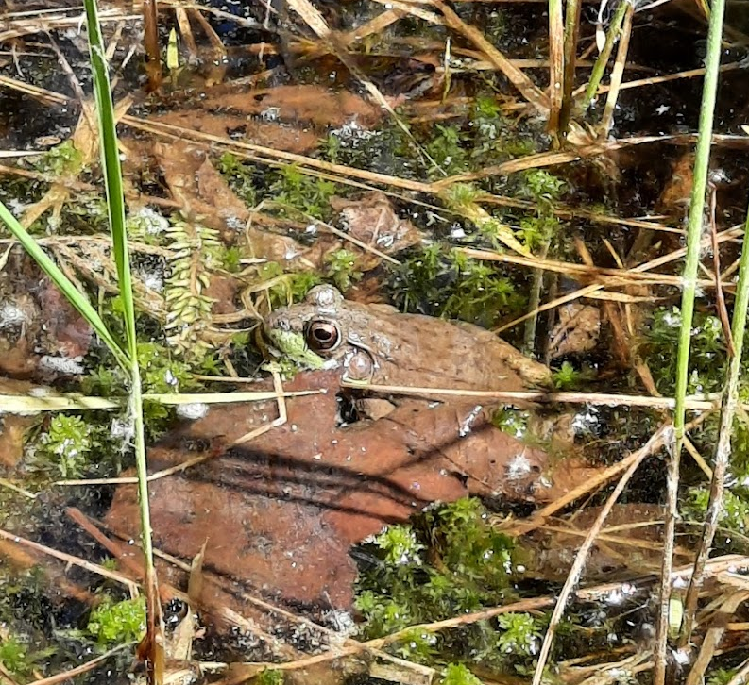
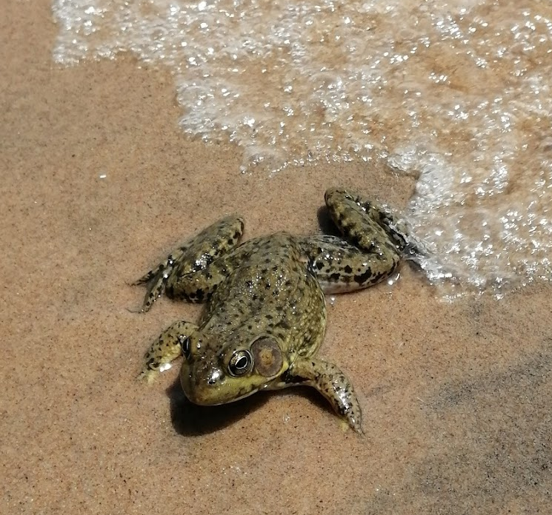
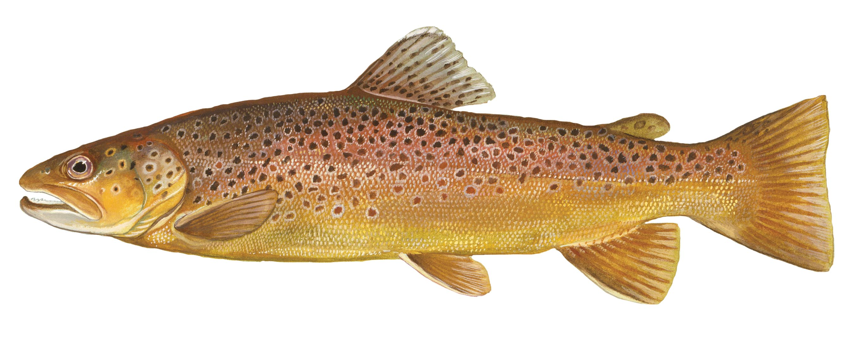
Predators
Bullfrog
Source: http://www.herprman.com/species/frogs/bullfrog
Fish
Green frog
Source: https://www.ncwildlife.org/learning/species/fish/brown-trout

